Slide 1

Module 2- Big Data Infrastructure
Hadoop Ecosystem-HIVE

Slide 2

Hadoop Ecosystem-HBase
Review of Sterday…..
How Hbase can serve as a NOSQL environment
Major points
Columnar Structure
Row Key, Column Family, Column and Values
Hbase/Cassandra
Architecture
CRUD operations

Slide 3

Two of your friends are working for E-Commerce Company
Hadoop Ecosystem-HIVE
How HIVE is different from RDBMS?

Slide 4
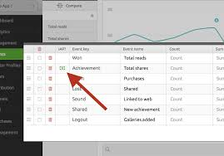

Hadoop Ecosystem-HIVE
First Person works for Revenue Analytics Team
Ajay
Revenue Analytics Team

Slide 5
Hadoop Ecosystem-HIVE
Major Responsibility
He should be in a position to answer questions.
How he equip himself with answers for the question?

Slide 6
Typical Flow of his job
9:00 AM
Sends Email to all category manager with the day’s company revenue
10:00 AM
category manager asks him to identify the reason for revenue drop
11:00 AM
Stupid technician pull three years record
3:00 PM
prepares a presentation with last weeks revenue performance
7:00 PM
Presents the deck to the management

Slide 7

Lets try to understand HIVE
Sujay
Order Management Team

Slide 8
Typical flow of his job
9:00 AM
opens up the order management portal and checks the status of all orders(pending and delay orders)
10:00 AM
She gets the updates of all orders for which she is responsible and call the agents to find the status
11:00 AM
Based on status updates, she accessed the risk of delay for each order
11:00 – 5:00
Calls all customers whose order will be delayed.(cancel,discount, reroute)
11:00 – 5:00
All should happen instantaneously
5:00 PM – 7:00 PM
urgent overnight delivery, stock out of order with one vendor,reassign to another vendor
7:00 PM – 9:00 PM
check all the status of the orders to be delivered today and logs off by handing over the details to next shift

Slide 9
Quick Comparison
AJAy-revenue analytics
SUJAY-order management
Batches
Read
Long Running Jobs
Multiple Data Sources
Individual orders
Read/Update
Instantaneous Jobs
Single Data Source

Slide 10
Both of them will look at order’s data
And
Both of them require tables to store the data

Slide 11
Analytical
Processing
Transaction
Processing
Vs

Slide 12
Differences
Transactional processing
Analytical PROCESSING
Still traditional RDBMS is used
Data warehouse ( database that serves specifically analytical needs)
VERTICA
TERRADATA
ORACLE
IBM

Slide 13

WHAT IS HIVE?
Open Source Data Warehouse built on top of Hadoop

Slide 14
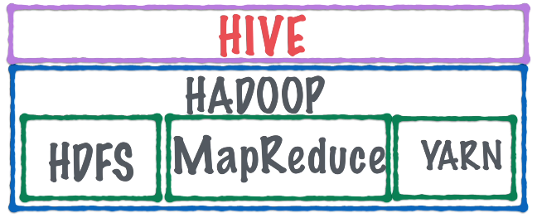
How Hive interacts with different components in Hadoop?
Hive stores its data in HDFS.
Hive provides an SQL like interface to data in Hadoop.
The files in HDFS are exposed to the user in the form of tables.
The user can write SQl like queries to work with these tables.
Hive will translate the query into 1/more mapreduce tasks.
The mapreduce tasks will process the data in HDFS and return any results to Hive.

Slide 15

One more component
The metastore is a database
Stores all the metadata for the tables in HIVE
HIVE data in HDFS is in the form of FILES and DIRECTORIES
Metastore maps these FILES and DIRECTORIES to HIVE TABLES
It holds the table definitions and schema
It also tells HIVE the process of reading a file and converting into a table
User can configure HIVE metastore
Default by Apache called DERBY

Slide 16
TRADITIONAL
RDBMS
HIVE
Vs

Slide 17
HIVE | TRADITIONAL RDBMS
Data warehouse | DBMS
Analytical Processing | Transactional Processing
Tool for Business Intelligence | Regular DBMS concepts
Batch Processing | Indexing
Schema on Read | Schema on Write
Not the sole owner of data, can be used and modified by others | No external database can access the database(ACID)
Hive may not always succeed in imposing a schema | No data without following the schema
Hive cannot enforce constraints as well as no row level updates/deletes | Everything can be enforced
Hive Supports more mathematical functions like covariance, median, mean | Sum,max,avg,min
It supports only equijoins no natural join | It supports all joins
Union is supported but no intersect and difference | It supports all

Slide 18
Can HIVE perform well for transactional processing?

Slide 19
SQL
HIVEQL
Vs

Slide 20
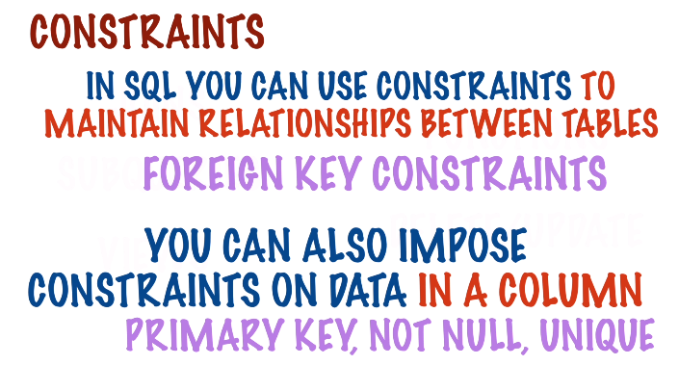
Hadoop Ecosystem-HIVE
HIVEQL Vs SQL

Slide 21
Hadoop Ecosystem-HIVE
HIVEQL Vs SQL
delete from employees where
firstname =“sudaroli”;
Update employees set
Lastname =“vijay”
Where firstname=“Niru”;
Delete/Update
They do not work in HIVE

Slide 22

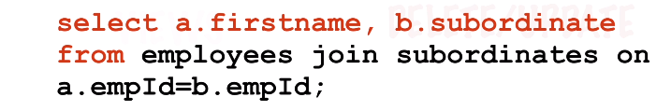
Hadoop Ecosystem-HIVE
HIVEQL Vs SQL
Joins
It allows user to control the execution of the join to some extent
HIVE supports only equijoins no natural joins

Slide 23


Hadoop Ecosystem-HIVE
HIVEQL Vs SQL
SUBQUERIES

Slide 24
Hadoop Ecosystem-HIVE
HIVEQL Vs SQL
Functions
Very powerful in HIVE
Along with regular mathematical functions like SUM,AVG etc
it do possess various statistical, datamining functions.
User defined functions

Slide 25
THANK YOU
“WORLD IS ONE BIG DATA PROBLEM”
“TORTURE THE DATA AND IT WILL CONFESS TO ANYTHING”

